Slide 1
A view into Software Cracking Kalli Schlauch – GCIH, CEH
How attackers bypass registration,
how not to protect your software and
how to get a handle on flipping jumps

Slide 2
Disclaimer
The content and views in this presentation are in no relation to my employer
I know nothing! – the content is not based on any training, rather my own observations and experiments from a long time back (yet still relevant)

Slide 3
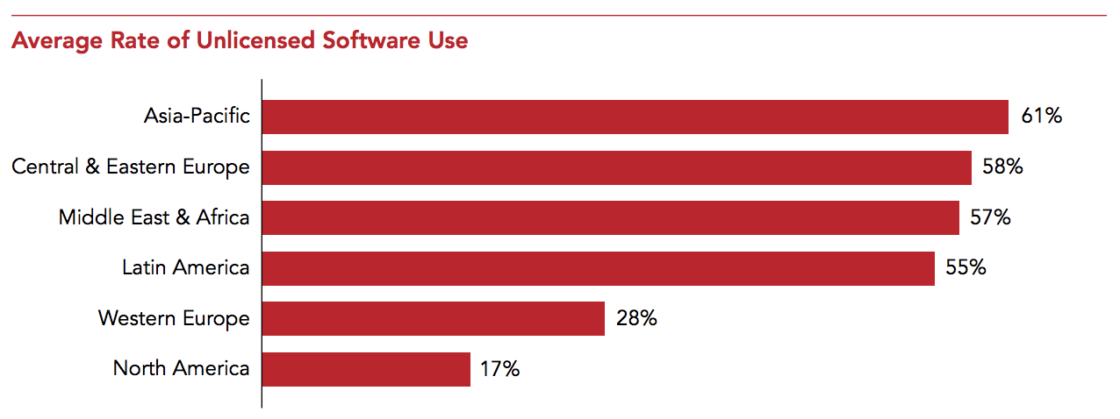
Piracy rate
Ireland: 32%
WEurope: 28%
Worldwide: 39%
BRIC: 64%
Notes:
Ireland 1% point less every 2 years (32% 2016, 33% 2014 … 35% 2009)
BRIC: Brazil, Russia, India, China
Sixty percent of consumers and workers identified security threats from malware as among the top reasons not to use unlicensed software.
Data: http://globalstudy.bsa.org/2016/downloads/studies/BSA_GSS_US.pdf

Slide 4
Software Cracking – Reverse Engineering
Why should we know about this subject?
You might be a software developer
nothing wrong with checking your own code
You might be offering such services
white hat!
Learn/Understanding Protocols and Processes
Troubleshooting and Implementation (grey area!)
Dissecting Malicious Code
Malware, Security industry and Security Consultants
Notes:
No legal issues with looking at your own code
A lot of crackers tried to make a business out of creating/selling software protection
Think windows closed source CIFS Samba protocol, how come samba project understands this protocol (samba team claims French café techniques. Good and Funny paper!)
This is critical. The whole security industry sectopr lives on this. We need to be able to exactly understand what a malicious software is doing to be able to protect others

Slide 5
Warez Groups
Release Model
From BBS days
if you want to download you need to upload first -> credits (1:x ratio)
Site owner does not want duplicates -> dupecheck
Release process (automated, file_id.diz, release.nfo) -> release DB entry and nuke
Internet Killed The BBS-star … (people like browsers - mid 1990s)
Release structure remained, modem direct access replaced with FTP/FXP
IRC became communication platform with interop to topsites
Warez groups use specific ftp for initial release ‘affil’
Notes:
Whoever makes the phone connection pays, so you are always better off running the BBS yourself higher risk
Phreakers typically didn’t pay (cornflakes whistle)
What if everyone uploads the same stuff?
Show d00per!
Show release.nfo

Slide 6
Warez Groups
The organization
Leader
Public relations, decide and prioritize, last word
Supplier
sources ‘fresh’ software. 0-day
Cracker
removes copy protection, license requirement
Packager
Adds nfo and file_id.diz, wraps, dupecheck. Avoid Nuke. Often also uploader
Tester
verifies software is successfully cracked/packaged, often also tested by supplier
Network guy
IRC and bots, FXP board member, organizes affils, access, provides BNC (bounced ftp/irc)

Slide 7
Cracking Groups (Warez groups)
Why?
Because they can
challenge of cracking/succeeding
Status
Bragging rights in the warez scene
Benefits
Safe, fast access to everything – Warez addiction
Monetary?
individuals downloading and toasting, warezgroups typically hate their stuff being leaked to public (piratebay, etc or worse - sold) -- mostly couriers?!

Slide 8
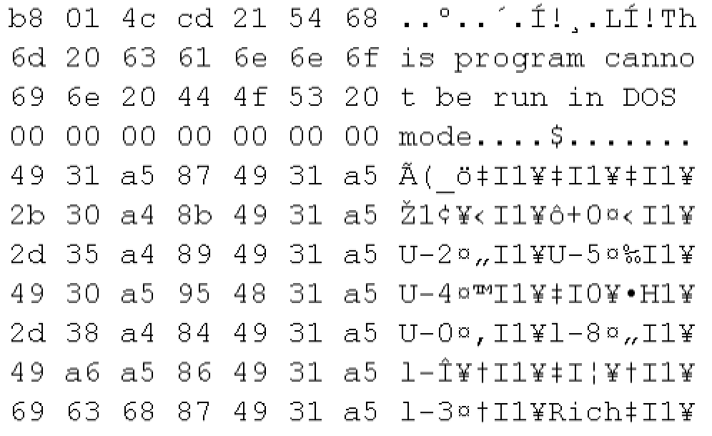
Windows Applications
Visual Studio, C++, Assembly, Machine Code
Libraries
Portable Executable (PE)
#include <stdio.h>
int main()
{
int a=2;
int b=3;
int c=a+b;
printf("result is %d", c);
return 0;
}
C-Compiler and linker
MOV EAX, 2
mov EBX, 3
ADD EAX, EBX
...
.section __TEXT,__cstring,cstring_literals
L_.str: ## @.str
.asciz "result is %d"
Assembler
Disassembler
Notes:
C++ most

Slide 9
Playing Hopscotch
Flipping Jumps!

Slide 10
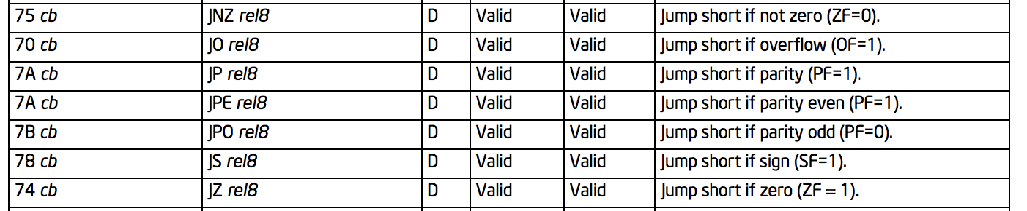
Assembly Opcodes
https://www.intel.com/content/dam/www/public/us/en/documents/manuals/64-ia-32-architectures-software-developer-instruction-set-reference-manual-325383.pdf

Slide 11
Demo
Let’s break Kalli’s Software

Slide 12
What was the downfall
Hardcoded strings – absolute No-No
Only 1 single check/jump - that’s even worse

Slide 13
How do I prevent this?
Near impossible to defeat an expert attacker
The way your prevention is implemented is more important than the technology! – lets look at that

Slide 14
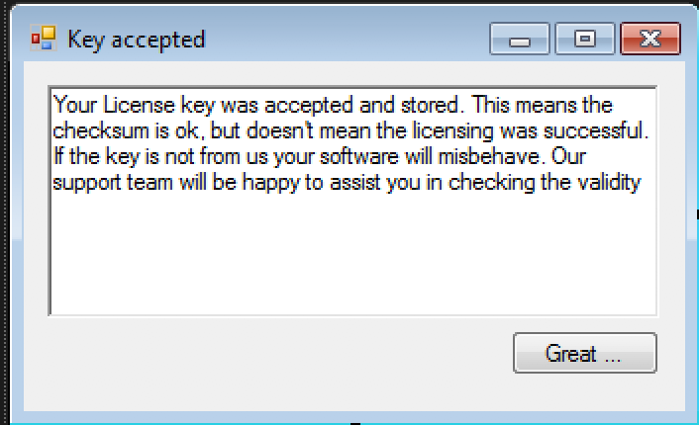
Registration Keys
No improvement in using reg files or registry entries
Highly complex algorithms are simply defeated if the check for correct key is simple
MachineID is good to prevent ‘normal’ users using the same license multiple times (small companies), doesn’t affect cracker in the slightest
Annoy the cracker!
Let him/her think its registered and misbehave slightly
Accept _any_ registration key
Notes:
Sysinternal suite to mnoniutor file create, read, write …
Even if we utilize cryptograophy, if at the end there is a single jump it will be easy target
Most crackers will know machineID and mac addresses off by heart and recognize them, also registration form gives this way (your unique ID will only work on this computer and is)
Make the cracker jump around the code until he/she gets sick of it. Misbehave. Saved file doesn’t open correctly, print contains ‘unlicensed’. Render it!!!! No hardcoded strings. Calculate it
Worst case scenario for an attacker:

Slide 15
Registration server
How complex is the data you send/return?
How complex is the check?

Slide 16
Dongle protection
Bad/simple dongle implementation
Dongle was implemented correctly but had side-effects
AutoCad Dongle problem
Cubase SX Dongle problem (Sentinel)

Slide 17
Steer Clear of
Nags
IsRegistered Flag
Hardcoded strings like “registration successful”, “invalid license key”
Supplying ‘crippled’ version that contains the code
Do
annoy the cracker (more!)
use the code somehow in the program
Don’t rely on system time, check system files, etc
Self-healing could be a possibility
Misbehave (subtle) if code is wrong but don’t alert

Slide 18
What next?
Where do I find further reading material?
To learn more about this subject there is an array of tutorials. Some of them even discussing specific software. Careful browsing …
OLD/still valid! HCU material +Fravia/+ORC (crawled) http://acrigs.com/FRAVIA/entran.htm
OLD/still valid! www.woodmann.com web archives of tuts, etc
https://beginners.re/ reverse engineering for beginners, free eBook
Debugging and key-generators: can I come back?

